Slide 1
4. Taxonomy induction

Slide 2
Taxonomy Induction
Information extraction
Extract isolated facts from documents, e.g., lion ISA animal
Taxonomy induction
Extract related facts from documents, e.g., classification of animals
Notes:
Information extraction concerns the extraction of isolated facts, such as ISA relationships. Taxonomy induction aims at extracting related facts and organizing them in a structured knowledge basis, e.g. a hierarchical taxonomy. It is a special case of the more general ontology induction, which organizes knowledge using arbitrary relationships.

Slide 3
Use of Taxonomies
Hyponyms (subordinate terms) can inherit properties from hypernyms (more general terms)
Due to transitivity of ISA, no need to learn inferred facts
No unique taxonomies
Depending on the perspective and application different taxonomies may be useful:
A tiger and a puppy are both Mammals and hence belong close together in a typical taxonomy, but tiger is a WildAnimal (in the perspective of Animal-Function) and a JungleDweller (in the perspective of Habitat), while a puppy is a Pet (as function) and a HouseAnimal (as habitat), which would place them relatively far from one another
Notes:
One of the advantages of taxonomy induction (and more generally ontology induction) is the possibility to perform inferences on the extracted knowledge. For example, in a ISA hierarchy, lower nodes in the hierarchy can inherit properties from higher nodes, thus these extra facts need not to be learnt separately.
One of the challenges in taxonomy induction is the fact that there is no notion of “correct” taxonomy. A taxonomy strongly depends in its intended use and on the specific perspective of the user on the domain. Integrating all possible perspectives into one single global taxonomy would not be feasible and useful, as the resulting taxonomy would potentially be too complex to be used.

Slide 4
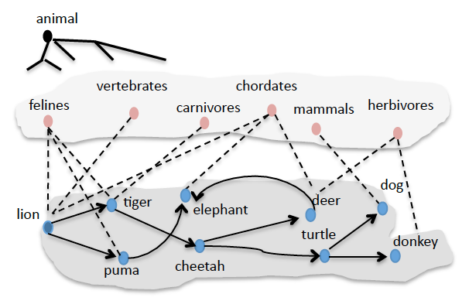
Taxonomy Induction Task
Starting from a root concept and a basic concept
Learn relevant terms and their hypernym / hyponym relationships
Filter out erroneous terms and relations
Induce a taxonomy structure
Notes:
We present in the following one specific approach to taxonomy induction, which was one of the first approaches proposed in the field. It starts from the assumption that one general concept (e.g. animals) and at least on basic concept of the taxonomy (e.g. lion) are provided as input. From this starting point the task is to identify more relevant concepts (represented as terms), establish the hypernym and hyponym relationships, filter out erronous terms and relations and finally induce an overall taxonomy structure. The figure illustrates the process: at the bottom level first more related terms are identified. Then intermediate concepts, more abstract than the basic concepts are identified. From this data finally the taxonomy will be induced.

Slide 5
Learning Terms
Template approach
Given a root concept c (e.g. animal) and a seed s (e.g. lion)
Hyponym pattern: P_{i}(c, s, X) = c such as s and X
Hypernym pattern: P_{c}(t₁, t₂, X) = X such as t₁ and t₂
Notes:
The basic idea is to learn terms and relationships by querying a Web search engine. As patterns language template capturing hypernym relationships are used. This is analogous to the approach with Hearst patterns for extracting ISA relationships. However, as in a first phase on has to detect more relevant terms, so-called double anchored patterns are used, that relate one (known) term to another (unknown) term of the same class of concepts. One example of such a pattern would be “c such as s and X”, where c and s would be known and from the result the term at position X would be a new term from the same class of concepts as c. Using such patterns new terms can be harvested by recursively applying the pattern to the terms known so far.

Slide 6
Finding Hyponyms
Recursively harvest new terms using a Web search engine
T = {s}; w(t) = 0
while T changes
for all t in T: submit P_{i}(c, t, X) to search engine
add to T all new terms t_{new} found in position X in a result
w(t)++

Slide 7
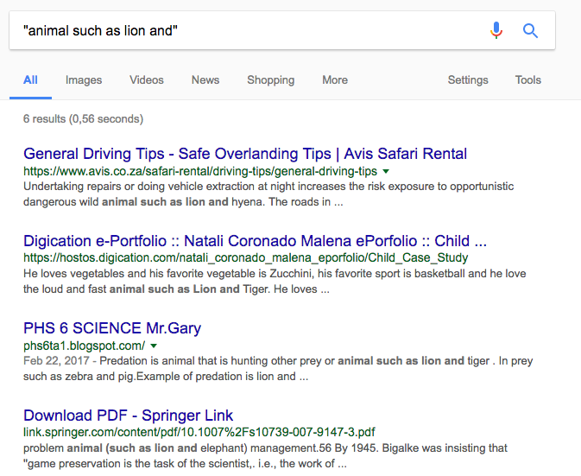
Example
Existing Term: lion
New Terms: hyena, tiger, elephant
Notes:
This is an example of how terms related to an initial term “lion” would be found using double-anchored patterns.

Slide 8
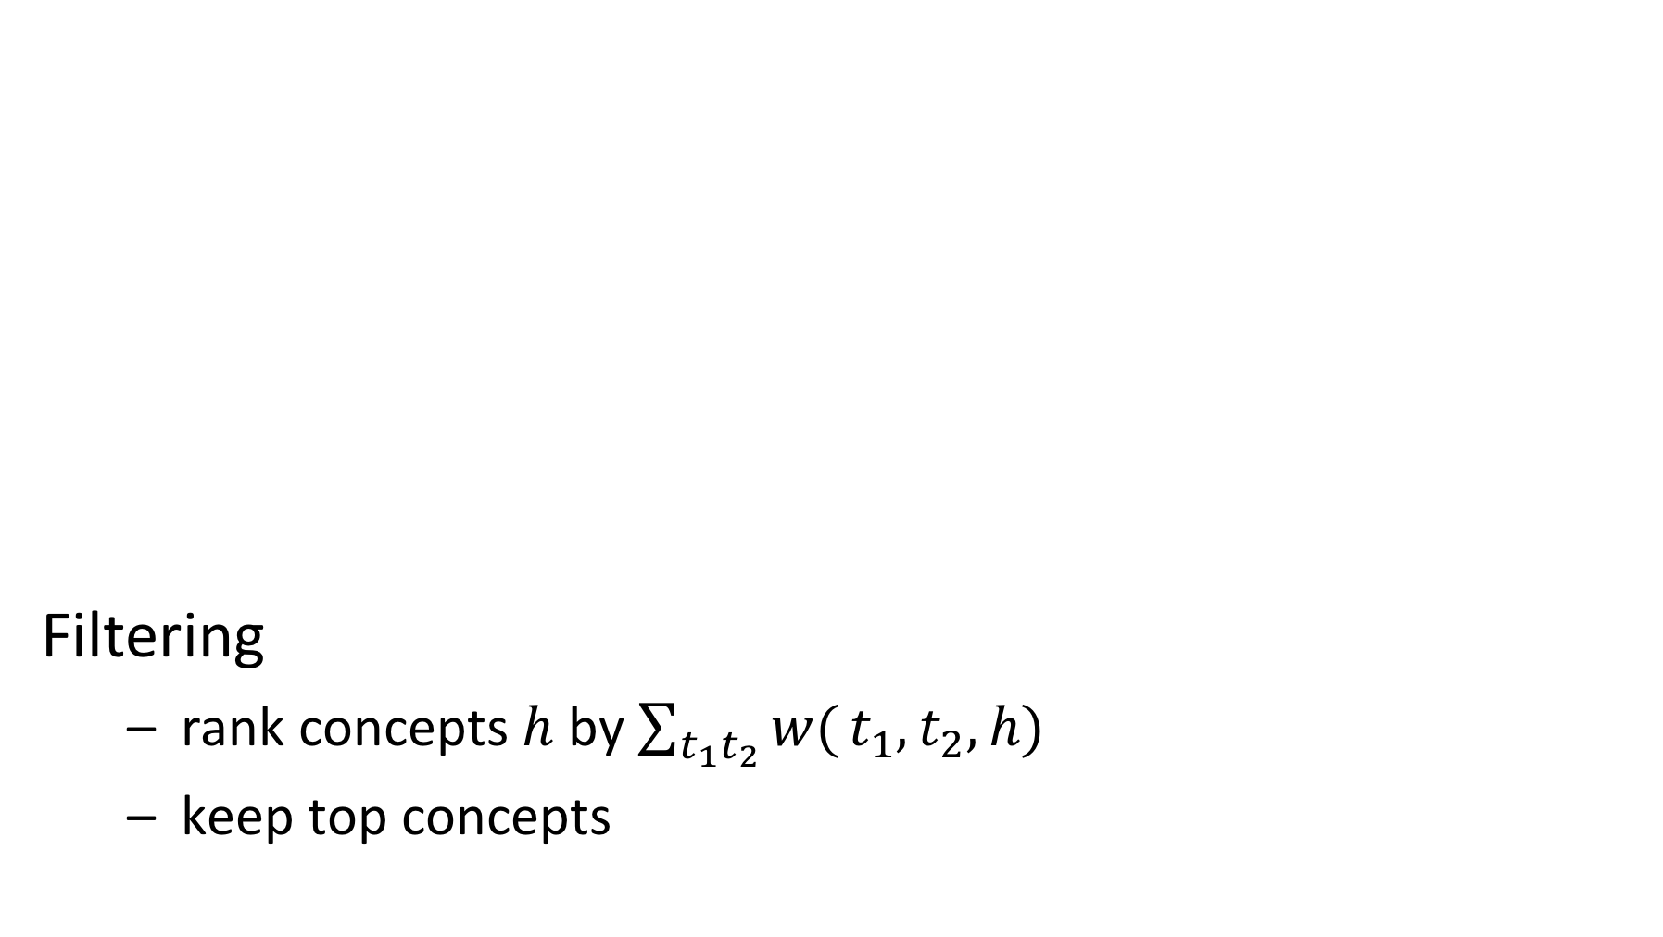
Finding Hypernyms
C = {c}
for all t₁, t₂ in T with w(t_{i}) > 0: submit P_{c}(t₁, t₂, X) to search engine
add new term h found in position X to C
add t₁ ISA h and t₂ ISA h to the hypernym relations H
w(t₁,t₂,h)++
Filtering
rank concepts $h$ by $\sum_{t_{1}t_{2}}{w(}t_{1},t_{2},h)$
keep top concepts
Notes:
Once the search for terms is completed, hypernyms can be searched by using the same patterns, but now be putting a variable X in the place of the concept, and using the basic terms found so far. In this search only terms that have been leading to the discovery of other basic concepts are being used, which is expressed by the condition w(t) > 0.
Once the search for higher level concepts is completed, a filtering step is performed. The concepts found are ranked by the number of times they have been discovered starting from different term pairs and only the highest ranked concepts are retained.

Slide 9
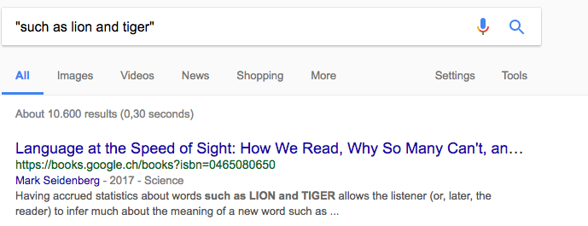
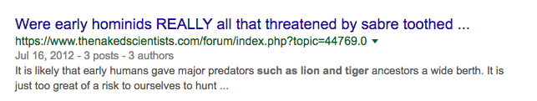
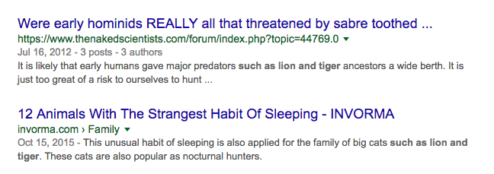
Example
New Classes: predators, big cats,
But also: words, …
Notes:
Here a few examples of how higher level concepts related to the basic concepts “lion” and “tiger” can be found.

Slide 10
Example Result
Discovery of concepts C
Discovery of terms T
Notes:
As a result of the two previous step we obtain basic data on terms for basic concepts T and higher level concepts C, together with hypernym relationships indicated by dotted arrows.

Slide 11
Inducing Hypernym Graph
Many possible relationships among concepts and terms have likely not been discovered
Result: A directed hypernym graph H
For each pair t₁, t₂ in T ∪ C
Construct query q₁ = h(t₁, t₂) and q₂ = h(t₂, t₁) with Hearst pattern h(X, Y), e.g., h(X, Y) = “X such as Y”
Submit query to search engine and count number of results
If #results(q₁) > #results(q₂) then add t₁ ISA t₂ to H else add t₂ ISA t₁ to H
Notes:
In the steps performed so far, many possible relationships among higher level concepts and basic concepts and higher level concepts may not have been discovered. For discovering those again queries against a search engine are performed, testing the two possible directions of a hypernym relationship for each pair of terms. The alternative that produces more results in the search is considered as being the correct one. As templates we can use any of the Hearst patterns, such as “X such as Y”, “X are Y that”, “X including Y”, “X like Y”, “such X as Y” etc

Slide 12
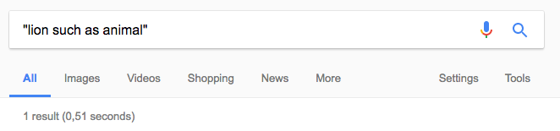
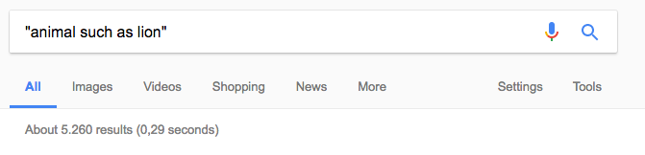
Example
Notes:
This example shows how powerful this method to test a direction of a relationship is.

Slide 13
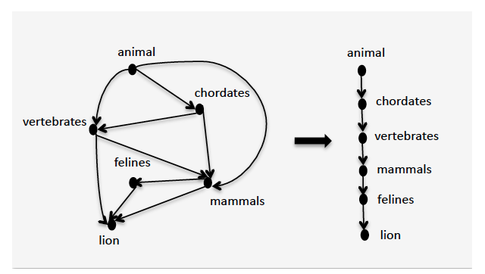
Example
Shortcuts
Graph H: may contain redundant paths
Notes:
After adding all possible relationships to the set of concepts, we obtain a a graph that contains many redundant paths, including many of the induced transitive relationships. The method would, for example, find that animal ISA chordate, and chordate is a vertebrate, but also that animal is a vertebrate. In the last step such redundant relationships are removed.

Slide 14
Cleaning the Hypernym Graph
Determine all basic concepts
Not hypernym of another concept
Determine all root concepts
Have no hypernyms
For each basic concepts - root concept pair:
Select all hypernym paths that connect them
Choose the longest hypernym paths for the final taxonomy
Notes:
For cleaning up the taxonomy graph, first the basic and root concepts are identified, which are the ones that are not hypernym of another concept, resp. have no hypernym. Then for every possible pair of a root concept and a basic concept all paths between the two are extracted, and only the longest one (or the longest ones) is retained.

Slide 15
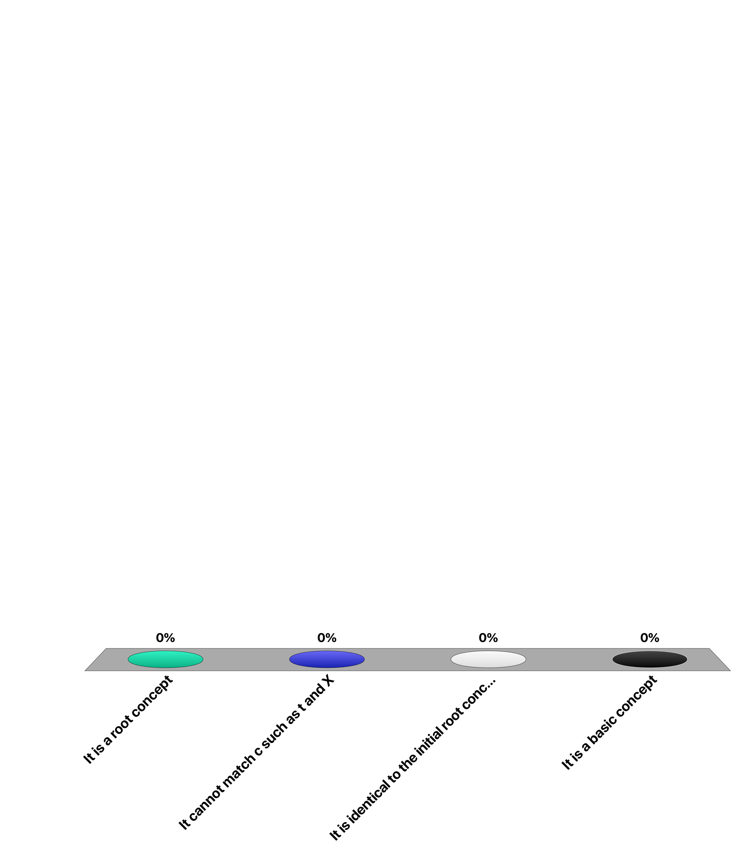
If t has no Hypernym ..
It is a root concept
It cannot match c such as t and X
It is identical to the initial root concept
It is a basic concept

Slide 16
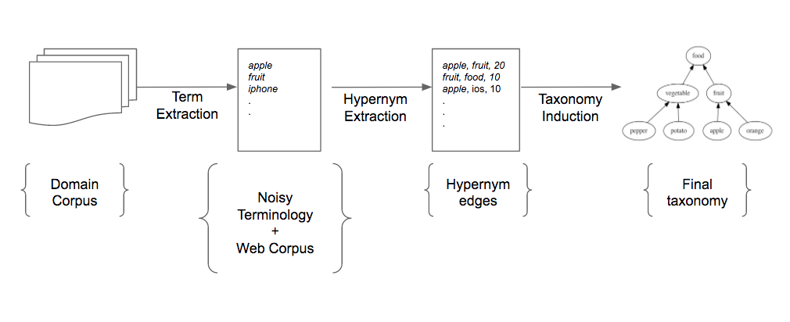
Taxonomy Induction: 7 years later
1. Seed term → Seed vocabulary
2. Web querying → Web corpus analytics
3. Basic statistics
→ Machine learning
Probabilistic
models
Big Data Processing
Probabilistic models
Machine Learning
Domain
Corpus
Web
Corpus
Gupta, Amit, et al. "Taxonomy Induction using Hypernym Subsequences.”, CIKM 2017
Notes:
We will present now a more advanced technique for automated taxonomy induction that we recently developed. It takes advantage of different advances in the available tools, but also incorporates some very fundamental ideas that have not been taken into account in the literature and largely help to improve the quality of results. The main ideas are the following:
Instead of starting from a clean predefined set of seed terms, the method starts from a document corpus and uses keyphrase extraction to generate an initial vocabulary. This vocabulary may be noisy, but the method will help to clean it up while generating the taxonomy.
Instead of querying the Web, the method uses a Hypernym database that has been generating from analyzing a Web corpus.
Instead of performing simple statistics, the method uses various machine learning techniques for inducing the taxonomy.

Slide 17
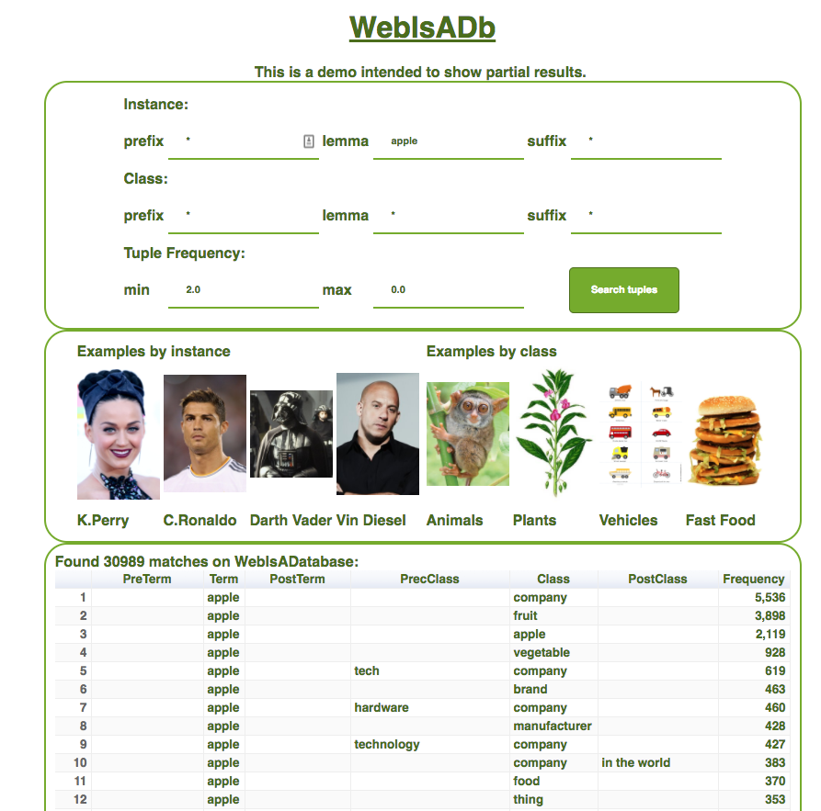
Hypernym Extraction: WebIsADB
http://webdatacommons.org/isadb/
Seitner, J., Bizer, C., Eckert, K., Faralli, S., Meusel, R., Paulheim, H. and Ponzetto, S.P., A Large DataBase of Hypernymy Relations Extracted from the Web. In LREC 2016
Notes:
We have already seen WebIsADB that is used in this method for determining potential hypernym relationships.

Slide 18
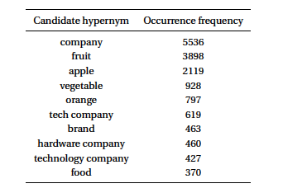
Example: Hypernyms for “apple”
Note that hypernyms occur at difference level of abstraction
e.g. apple – fruit – food
Notes:
WebISDB provides statistics of how often a term is in a possible hypernym relationship with another term. The example shows that the same term can be related to different terms at different levels of abstraction.

Slide 19
Key Observations
Current approaches in the literature make two main assumptions
The vocabulary is free of noise
Requires manual cleaning step before taxonomy induction
They assess taxonomy quality by estimating the probability of correctness of individual hypernym relationships
There is evidence that this works not well for more general terms
Notes:
In particular the second assumption is important. Considering only individual hypernym relationships for assessing correctness means that contextual knowledge, i.e., the other relationships the terms have, is not considered and thus important information is lost.

Slide 20
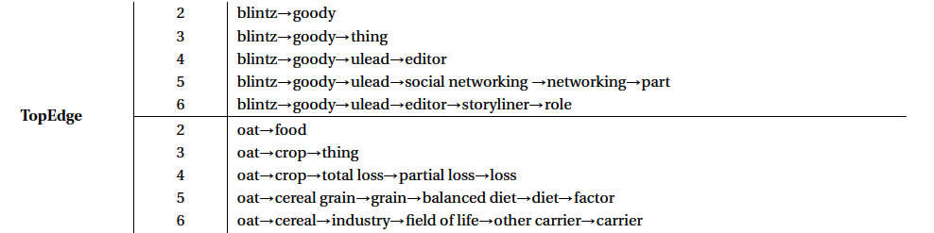
Semantic Drift in Generalization
Notes:
Considering only individual hypernym relationships frequently results in semantic drift, in particular at the higher levels of the taxonomy.

Slide 21
Key Ideas
Allow noisy vocabulary, but clean the resulting taxonomy after induction
After taxonomy induction more information is available to identify noisy terms
Estimate the probability of correctness of a complete path of hypernym relationships!
More contextual information is exploited in assessing the correctness of hypernym relationships
Notes:
Based on the two key observations, two key ideas are applied in order to achieve better performance in taxonomy induction. Both ideas are based on the approach of exploiting more contextual information when performing the taxonomy induction task.

Slide 22
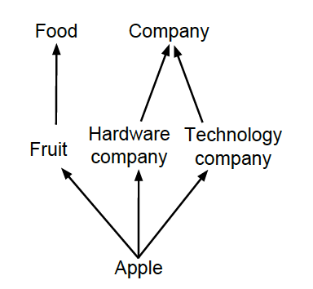
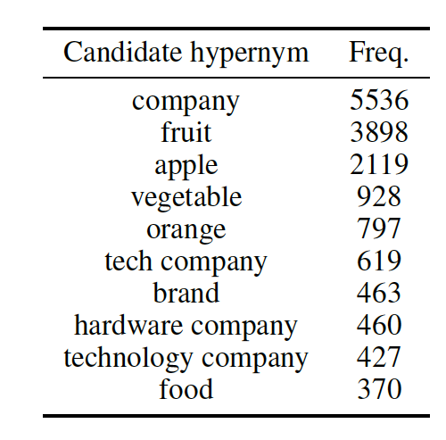
Approach
Find a DAG of generalizations
Starting from one seed term in the vocabulary, e.g., “apple"
Only one path for each hypernym of the seed term
Evidence E
Graph G
Notes:
The basic approach of the method is to induce for each term in the vocabulary a DAG that consists of hypernym paths from the term to a root concept. In the approach it is assumed that for every hypernym of the term only a single path is generated. Each of the paths can correspond to a different sense of the term.

Slide 23
Probabilistic Model
Ideally: given the evidence E, find the most probable Graph G argmax_{G} P(G|E) (not feasible)
Aproximation: argmax_{G} P(G|E) = argmax_{G} ∏_{i} P(E|S_{i}) × P(S_{i})
where S_{i} subsequence from seed term to a root
An independence assumption
But weaker than assuming all hypernym edges are independent of each other!
Need to estimate P(E|S_{i}) and P(S_{i})
Notes:
Ideally, we would find the most likely graph structure, given the evidence E provided in the hypernym database. Since it is not feasible to explore the complete space of all possible graphs, we will apply an independence assumption. We assume that the different paths from a leaf to the root of a hypernym graph are independent of each other (which is of course not correct, since the paths are in general overlapping). But in this way we need no more to estimate the probability of a graph, but only those of path. Note that this is still a weaker independence assumption than the one being made when assuming that al hypernym edges are independent of each other.

Slide 24
Solution Strategy
Estimation of probabilities of subsequences
Search strategy for subsequences
Optimizing the resulting DAG

Slide 25
Probability Estimation: P(S)
For S = t → h₁ → h₂ → h₃ → … → h_{n}
P(S) = P(t, h₁) x P(h₁, h₂) x … x P(h_{n-1}, h_{n})
P(a, b) - edge probability

Slide 26
Edge Probability
P(a, b) ∝ exp( w . f (a, b))
Edge features f(a, b)
Normalized count, n(a, b) = freq(a, b) / max_{c} (freq(a, c))
Normalized difference
String-based features (prefix, suffix, substring, length)
Generality based features
Weights w obtained from a classifier trained on a manually annotated set of edges

Slide 27
Probability Estimation: P(E|S)
For S = t → h₁ → h₂ → h₃ → … → h_{n}
P(E|S) = ∑_{j} P(E_{j}|S)
P(E_{j}|S) ∝ max(sim(E_{j}, h_{i})) for all h_{i}
sim (a, b) = max(P(a, b), P(b, a))
Why maximum (and not, e.g., sum)?
Consider S = apple→fruit→food→substance→matter→entity
For the term E_{j} = fruit, the hypernyms matter and entity occurring in the sequence should not hurt, even when unrelated

Slide 28
Intuitive Interpretation
Pr(S) promotes subsequences, which consist of individual edges with a larger probability of hypernymy
Pr(E|S) promotes subsequences, which contain a larger number of candidate hypernyms from E

Slide 29
Finding Optimal Subsequences
Basic algorithm
Iterate over all candidate hypernyms h of t
For each h perform a depth-limited beam search over the space of possible subsequences by recursively exploring the candidate hypernyms of h
For each h choose the subsequence S with the highest score
Choose the top-b candidates based on sequence scores
Notes:
Problem: for term t, find best subsequence with first edge t→h

Slide 30
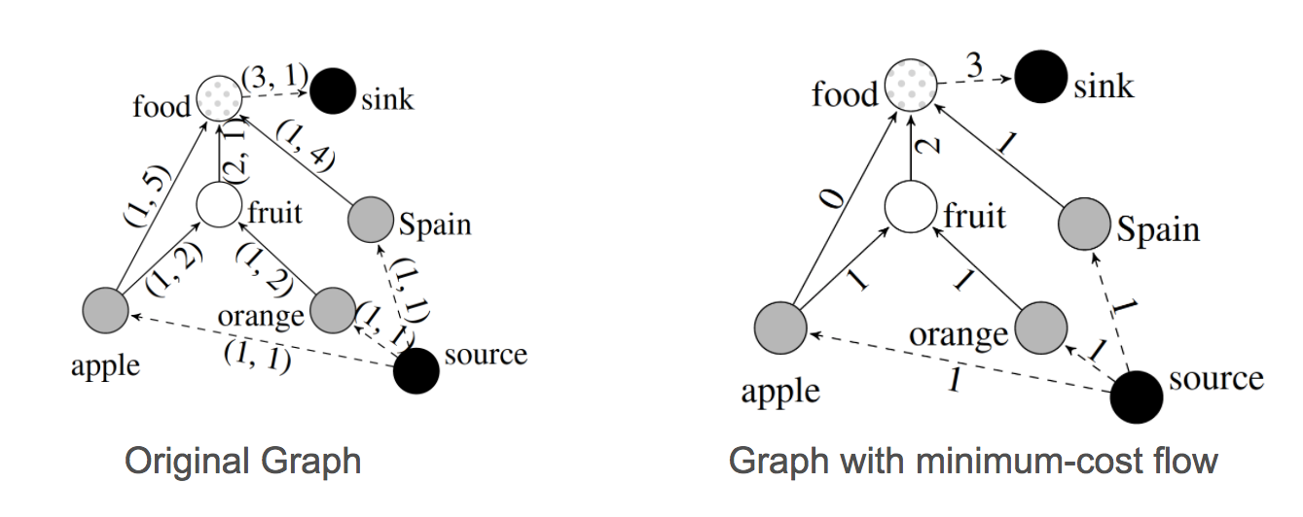
Optimizing the Resulting DAG G
Objective: prune the DAG composed of the set of subsequences constructed (noise removal)
Flow Network Optimization
demand controls how many seed terms should be discarded
Cost related to quality of paths

Slide 31
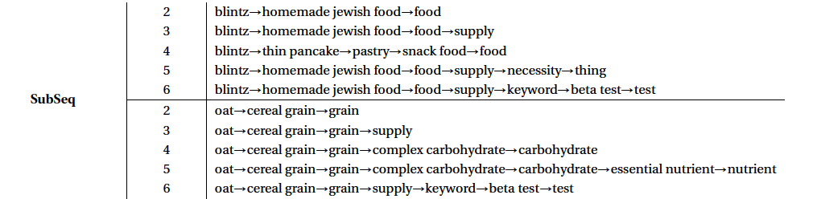
Results

Slide 32
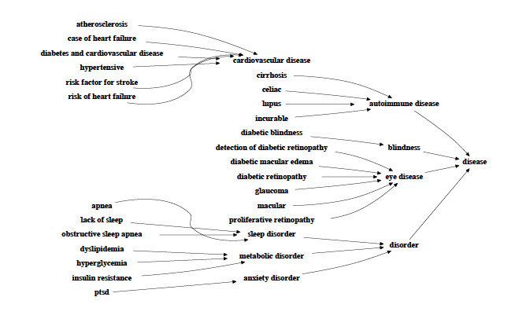
Example: Resulting Taxonomies

Slide 33
References
Course material based on
Kozareva, Zornitsa, and Eduard Hovy. "A semi-supervised method to learn and construct taxonomies using the web." Proceedings of the 2010 conference on empirical methods in natural language processing. Association for Computational Linguistics, 2010.
Gupta, A., Lebret, R., Harkous, H., & Aberer, K. (2017, November). Taxonomy Induction using Hypernym Subsequences. In Proceedings of the 2017 ACM on Conference on Information and Knowledge Management (pp. 1329-1338). ACM.
Faralli, Stefano, et al. "A Web application to search a large repository of taxonomic relations from the Web." CEUR workshop proceedings. Vol. 1690. RWTH, 2016.

